Slide 1
TDI EXCEL CAPSTONE PROJECT: LOAN RISK ANALYSIS

Slide 2
Content
Introduction
Problem Statement
Objectives
Dashboard
Key Insights
Recommendations and Conclusion

Slide 3
Introduction

Slide 4
Introduction: Project Overview
Project Background: The Data Immersed (TDI) specializes in providing loans to individuals and small businesses.
Aim: To improve understanding of loan performance, reduce risks, and enhance customer satisfaction.
Project Deliverables: Interactive Excel dashboard for loan data analysis. Insights to guide decision-making on approvals, interest rates, and risk management.

Slide 5
Problem Statement
TDI Challenges include:
High loan default rates affecting profitability.
Insufficient borrower risk profiling leading to suboptimal decisions.
Need for better optimization of loan approval and interest rates.
Purpose: Address these issues through data analysis and visualization.

Slide 6
Objectives
The objectives of the project are:
To analyze key metrics such as default rates, interest impacts, and loan segmentation.
To identify risk factors and patterns in loan approvals and rejections.
To develop an interactive dashboard for exploring trends and making decisions.
To draw insights into loan performance and customer demographics.
Provide actionable recommendations to enhance risk management and profitability.

Slide 7
Loan Analysis Dashboard

Slide 8
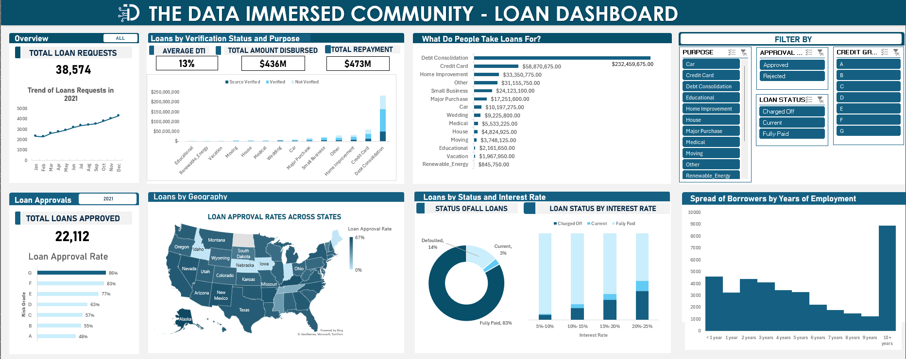

Slide 9
Key Insights
TOTAL AMOUNT DISBURSED
TOTAL REPAYMENT
$436M
$473M
Total sum of all loan disbursed is $436M while total repayments is $473M.
14% of all Loans are Charged off (Defaulted), this represents quite an amount and needs to be further investigated.
Spread of all Loans by Status

Slide 10
Key Insights
What do people take loans for?
People take or request for loans mostly for Debt Consolidation
Debt consolidation involves combining multiple debts into one by taking a new loan or credit card with a lower interest rate.
This means that most of TDI’s borrowers use the loans to service other loans, this is concerning.

Slide 11
Key Insights
Loan Approval Rate
Loans classified under Grade G have the highest approval rates

Slide 12
Key Insights
Trend of Loan Requests in 2021
There has been a steady increase in the number of loan requests with December 2021 having the highest number of loan requests

Slide 13
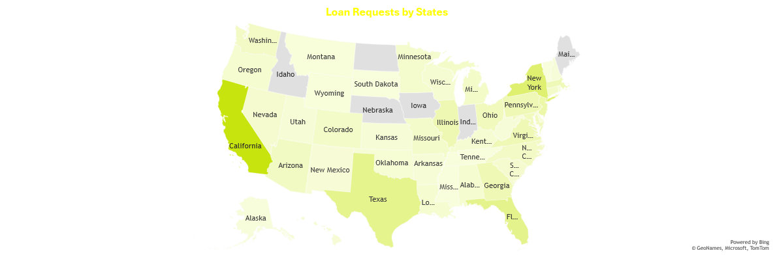
Key Insights
Most of the borrowers are residents in California with 4,104 requests with New York coming at 2160 requests.
Tennessee has the lowest loan requests at 4.

Slide 14

RECOMMENDATIONS
Address Loan Defaults (14% Charged Off):
Introduce stricter creditworthiness checks, especially for borrowers seeking high-risk loans such as Debt Consolidation.
Offer financial literacy programs to educate borrowers on managing consolidated debt effectively.
Manage Dependence on Debt Consolidation Loans:
Diversify loan offerings to reduce reliance on debt consolidation as the primary loan purpose.
Implement targeted marketing for other loan categories (e.g., business or education loans).
Introduce financial advisory services to assist borrowers in resolving underlying financial challenges without over-reliance on loans.

Slide 15
RECOMMENDATIONS
Optimize Loan Grading and Approval Policies:
Assess why Grade G loans have the highest approval rates and ensure grading criteria align with risk management goals.
Adjust grading thresholds to improve balance between approval rates and borrower risk.
Regional Expansion and Targeting:
Focus on underserved regions like Tennessee with campaigns to promote awareness and accessibility of loans.
Continue leveraging high-demand areas like California and New York but evaluate regional repayment performance to tailor risk management strategies.

Slide 16
Conclusion
The analysis highlights TDI’s strong performance with $473M in repayments exceeding the $436M disbursed. However, the 14% default rate and over-reliance on debt consolidation loans indicate potential risks.
Recommendations focus on reducing default rates, diversifying loan purposes, optimizing grading criteria, and expanding outreach to underserved regions.
By implementing these strategies, TDI can enhance profitability, mitigate risks, and ensure sustainable growth in its loan portfolio.

Slide 17
Thank you
Chinedu Uzorue
uzoruechinedu@gmail.com https://www.linkedin.com/in/chinedu-uzorue-12b101b7/

